Slide 1
Async & await with spheros
4-7

Slide 2





Team
Lohitha Bam
Lohitha Bhethalam
Sandeep Devineni
Daiwei Chen
Divyaharshini Bheemireddy
Sagar Tiwari
Team

Slide 3
Overview
Async
Promise
Await
Sphero

Slide 4
What is Async?
•An asynchronous model allows multiple things to happen at the same time.
•Every Sphero program starts with the following function:
•async function f() {
// perform operation
return 1;
}
The word “async” before a function means one simple thing: a function always returns a promise.
Presented By: Divyaharshini

Slide 5
What is a Promise?
•A promise is a special kind of javascript object which contains another object.
•Every async function you write will return a promise, and every single thing you await will ordinarily be a promise.
•The constructor syntax for a promise object is:
•let promise = new Promise(function(resolve, reject) {
// executor ( the producing code, “text”)
});
Presented By: Divyaharshini

Slide 6
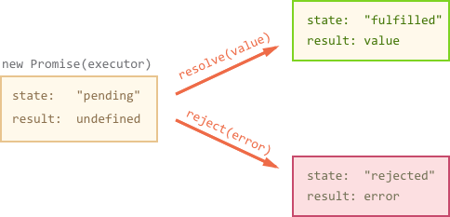
Properties of promise object:
•State – pending, fulfilled or rejected.
•Result – undefined
Presented By : Divyaharshini

Slide 7
Functions:
How do I access the data in a promise? I use `.then()`:
How do I catch the errors from a promise chain? I use `.catch()`
function getFirstUser() {
return getUsers().then(function(users) {
return users[0].name;
}).catch(function(err) {
return { name: 'default user' };
});
}
Presented By : Divyaharshini

Slide 8
What is AWAIT?
The keyword await makes JavaScript wait until the promise is completed and returns a value.
async function foo(){
let promise= new promise((resolve,reject)=>{
setTimeout()=>resolve(“This is the promise function”,3000)
});
let res=await promise;
alert(res);
}foo();
Presented By: Sandeep Devineni

Slide 9
Using await function
We cannot use await function in non-async function, If we try to do that we will get a syntax error.
Here is an example of that:
Function foo() {
let promise = Promise.resolve(1);
let result = await.promise; //syntax error
}
Presented By:Sandeep Devineni

Slide 10
The usages of async and await
•Ajax call returning data.
•Accessing users webcam.
•Resizing the image.
•Network and I/o operations
Presented By: Sandeep Devineni

Slide 11
Async and Await usage in sphero:
async function startProgram() {
await roll(0, 47, 3);
await speak('This is a demo program ', true);
await Sound.play(true);
}
Presented By: Sandeep Devineni

Slide 12
Benefits of asynchronous programming using async / await:
•Responsiveness
•Organize your code
Presented By: Sandeep Devineni

Slide 13
Sphero
Sphero robots are fun, durable and programmable toys, first invented by Lan Bernstein and Adam Wilson in 2011!
Sphero balls are programmed with javascript.
You need:
•Sphero robot
•Sphero edu app
•Hunger to learn
Presented By: Lohitha Bhethalam

Slide 14
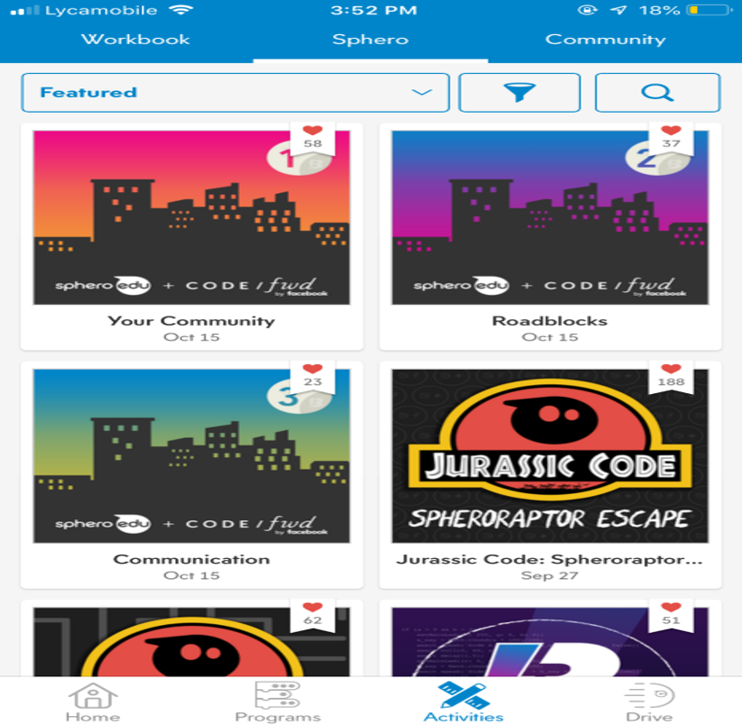
New to Sphero?
Presented By: Lohitha Bhethalam

Slide 15
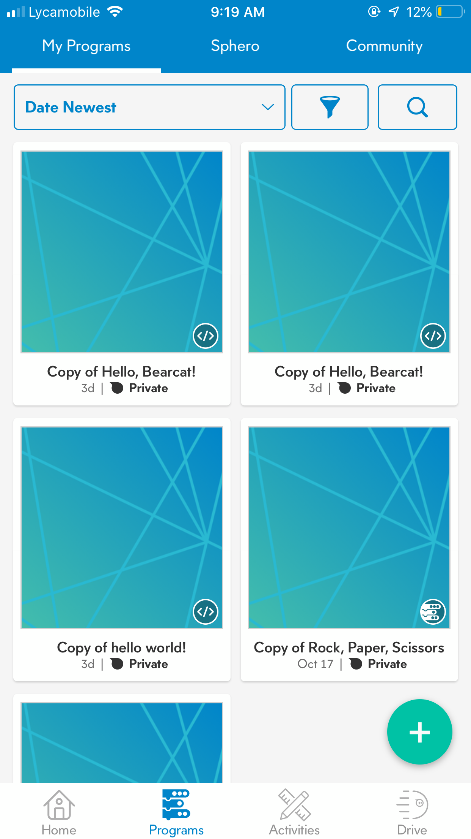
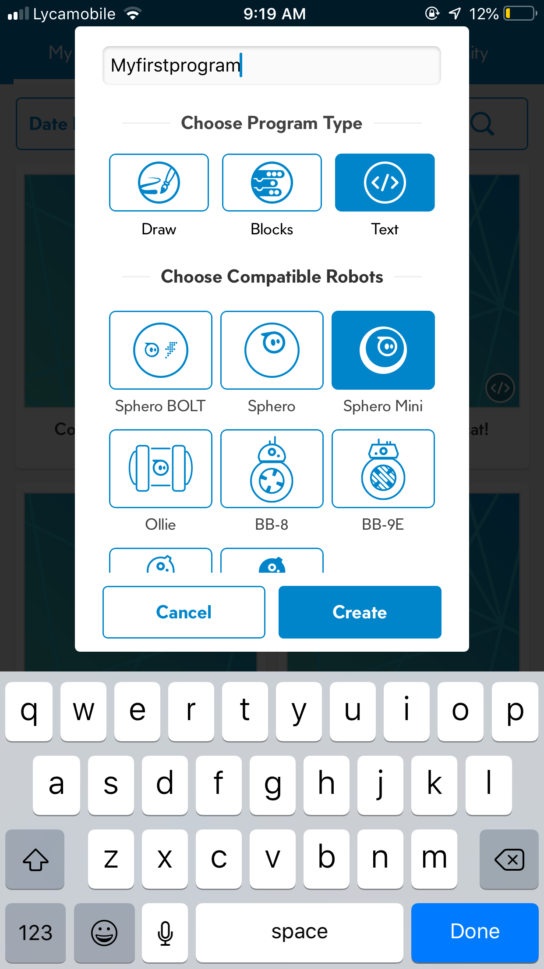
Writing your own program on Sphero edu
Presented By: Sagar Tiwari

Slide 16
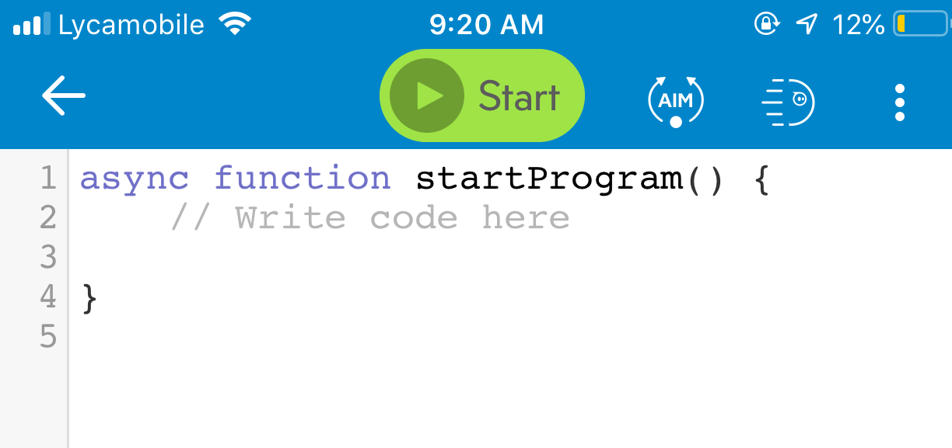
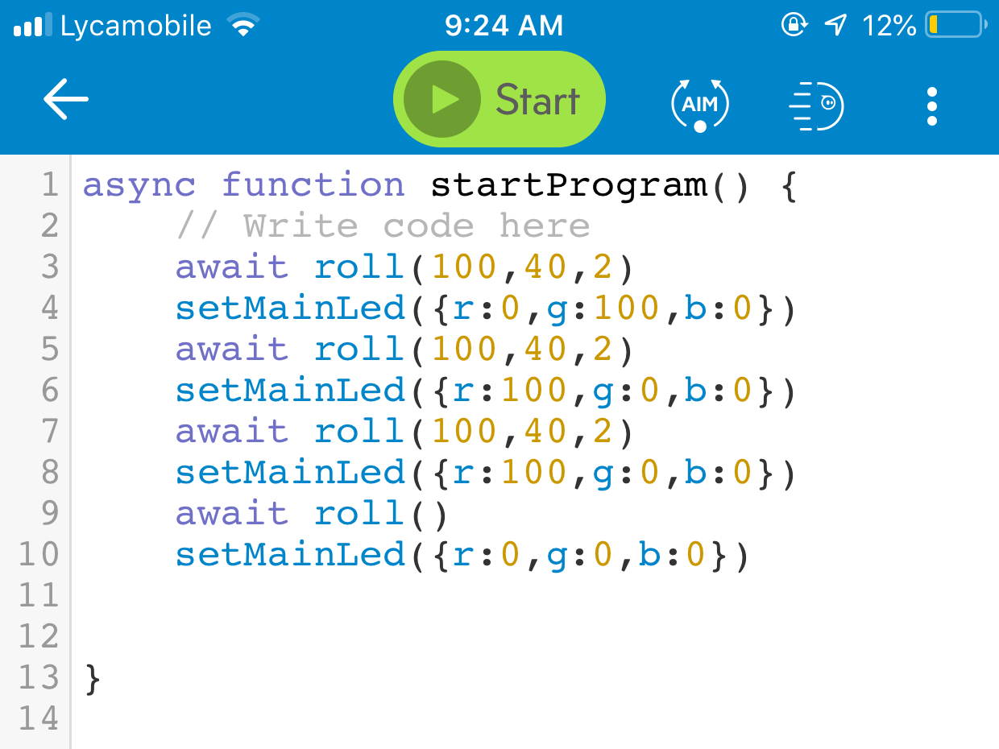
Writing your own program on Sphero edu
Presented By: Sagar Tiwari

Slide 17
Async Await Demo!
Presented By: Daiwei Chen

Slide 18
Thank You!

